Slide 1


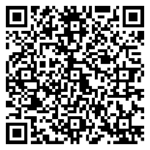
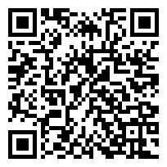



TOPIC
Roadmap to PDPL Compliance
Opportunities & Challenges
Takeout of the Session:
Introduction to PDPL
Data Privacy Principles
Key Requirements
PDPL Executive Regulations for Saudi Arabia
Opportunities and Challenges
26
Sept
45 Mins Session &
15 Mins Q&A
4 PM-5 PM | GMT+3
SPEAKER
Mr. Ajit Kushwaha
Scan to Register
Zoom Link
Principal Consultant
www.ecovisalsabti.com
@ecovisalsabti
@ecovisalsabti9155

Slide 2
01
Introduction to PDPL

Slide 3
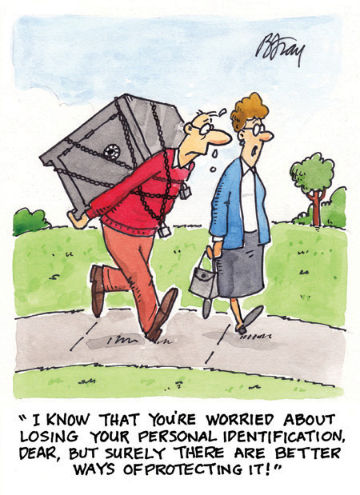

What is Privacy?
Privacy is the right to be left alone, free from interference or intrusion.
Before Digital Age
In Digital Age

Slide 4






















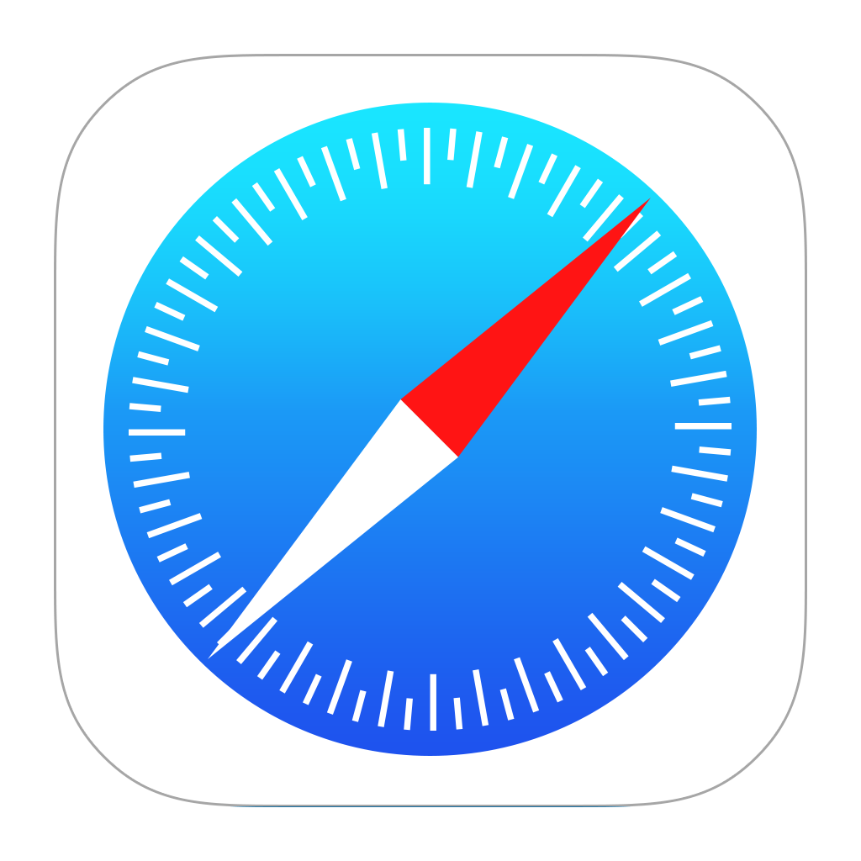
Why Privacy?
Passport
Financial
Info
Email
Preferences
National
ID
D.O.B
Name
Biometric
Info
Data Subject
Data Controller
Data Processor
Deep Fake

Slide 5

Threats to Businesses
Regulatory
Security
Organization | Impact
T-Mobile (January 2023) | Affected 37 million customers
Uber (September 2022) | Affected 57 million customers
Microsoft (September 2022) | Affected over 65,000 entities globally
Crypto.com (January 2022) | 500 accounts were accessed, resulting in the theft of more than $31 million
Microsoft (January 2021) | 30,000 US companies (60,000 companies worldwide)
Data Breach, Data Leakage
Declining Share Price
Regulatory
Non-Compliance
Adverse Employee/ Customer Reaction
Loss of Profit
Brand Damage
Commercial
Threat
Impact
Few major breaches

Slide 6
Drivers for Privacy
Changes to Customer and Employee Attitudes
Change in The Way Business is Conducted
Digital Identity and Rapid Technology Change
External Threats and The Evolving Landscape
Regulatory Compliance
What is required to create an ecosystem that can protect the personal data of all Individuals and enable business growth?

Slide 7

PDPL Introduction
The Personal Data Protection Law (PDPL) is a pivotal legal framework aligning seamlessly with the ambitious goals of Saudi Arabia's Vision 2030.
The PDPL applies to:
Personal data and
Sensitive personal data
Eligible entities operating in Saudi Arabia include:
Businesses
Government agencies
Non-profit organizations
Any other legal entities
The PDPL applies to:
Public or
Private organizations
Notes:
Make it bit

Slide 8
02
Data Privacy
Principles

Slide 9



Data Privacy Principles
Data privacy principles serve as foundational guidelines for how organizations and individuals should handle and protect sensitive information.
Storage Limitation
Data Minimization
Accountability
Purpose Limitation
Data Security
Lawfulness and Fairness
Data Privacy Principles
Accuracy

Slide 10
03
Key
Requirements

Slide 11










Key Requirements
Data Subject Rights
Data Transfer Outside Kingdom
Consent
Data Minimization
Data Processing
Impact Assessment
Data Breach Notification & Penalties
Data Security
Record of Processing Activities
Data Protection Officer

Slide 12







Data Subject Rights
Right to Information
Right to Correction or Completion
Right to Access
Right to Data Deletion
Right to Data in Readable Format
Right to Timely Responses
Action to be taken
Inform data subjects of their data privacy rights and develop a procedure to handle data subject requests.

Slide 13
Consent
Consent is defined as a clear, explicit, and voluntary agreement from the data subject to the processing of their personal data for specific purposes. This consent must be informed, unambiguous, and given freely.
Obtaining Consent
Explicit Consent
`
Conditions for Consent
Consent Exceptions
Action to be taken
Obtain consent before capturing and processing personal and sensitive personal data of individuals.

Slide 14
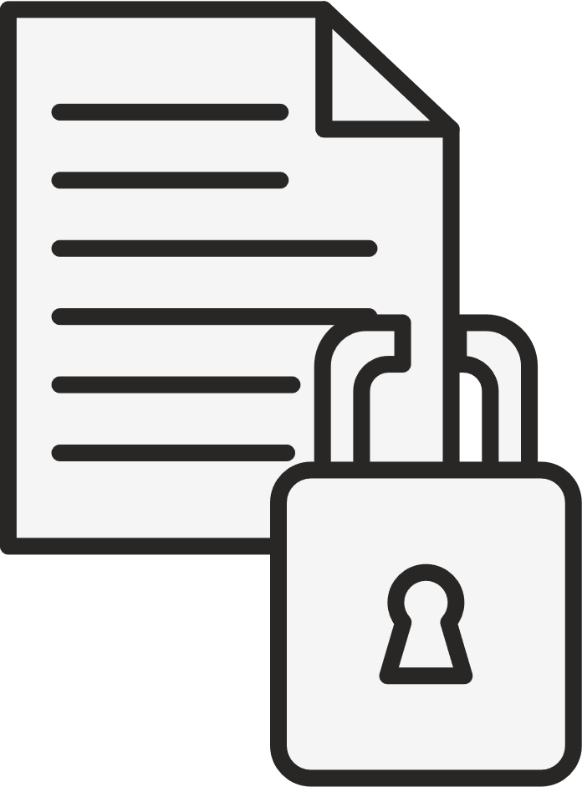


Data Transfer Outside Kingdom
Personal data may be transferred outside the Kingdom:
If the data subject has provided explicit consent
If there is a legal obligation requiring such a transfer.
  An agreement, serving the interests of the Kingdom and fulfilling obligations of the data subject.
  Does not impact national security or the vital interests of the Kingdom.
  Requires an adequate level of protection
  Extreme necessity to preserve life or vital interests, or to prevent, examine, or treat diseases.
Action to be taken
Ensure data processing agreement is signed with the data recipient and there is a control in place to protect privacy of data subjects.

Slide 15
Data Breach Notification
Organizations processing personal data have a legal obligation to promptly report data breaches that may compromise the security of personal data within 72 hours. The key elements of Data Breach Notification include:
Reporting Obligations
Data Subject Notification
Information to be Included
KEY ELEMENTS
Competent Authority Notification
Exception to Notification
Record-Keeping
Action to be taken
Develop a procedure to identify, contain, notify, resolve, and monitor data privacy incidents.

Slide 16
Roadmap to Compliance
Benefits
Establish a Data Privacy Governance structure and initiate a program to implement and monitor controls.
Governance
Data-Driven Innovation
Prepare Register of Processing Activities (RoPA)
Data Inventory
Ethical Data Practices
Inform data subjects of their data privacy rights; develop a procedure for consent management and for handling data subject requests.
Consent & Rights
Enhancing Trust
Establish Data Processing Agreements (DPA) with Data Processors.
Agreements
Privacy Protection for a Digital Future
Implement physical and logical data security controls to protect personal data.
Security

Slide 17
04
PDPL Implementing Regulations

Slide 18
What’s new in PDPL Implementing Regulations
The Implementing Regulations are published by SDAIA on 7 September 2023 and provide further clarity on articles covered in the PDPL, including the following:
Clarity is provided on personal or family use of Personal Data
Defines three different types of interest
Data Subject Rights are further explained in detail
Introduces and defines Pseudonymisation and Anonymization
Updates in Data Transfer outside the Kingdom
Processing of Health Data and Credit Data

Slide 19
05
Opportunities
and Challenges

Slide 20
Opportunities
Advanced Encryption Techniques
Artificial Intelligence and Machine Learning
Privacy-Enhancing Technologies
Enhanced Security Awareness and Education
Collaboration and Industry Standards

Slide 21
Challenges
Cyber Threats and Attacks
Data Breaches & Privacy Concerns
Insider Threats
Third-Party Risk Management
Evolving Technology & Regulatory Landscape
Cost of Maintaining Data Privacy

Slide 22
Q & A

Slide 23

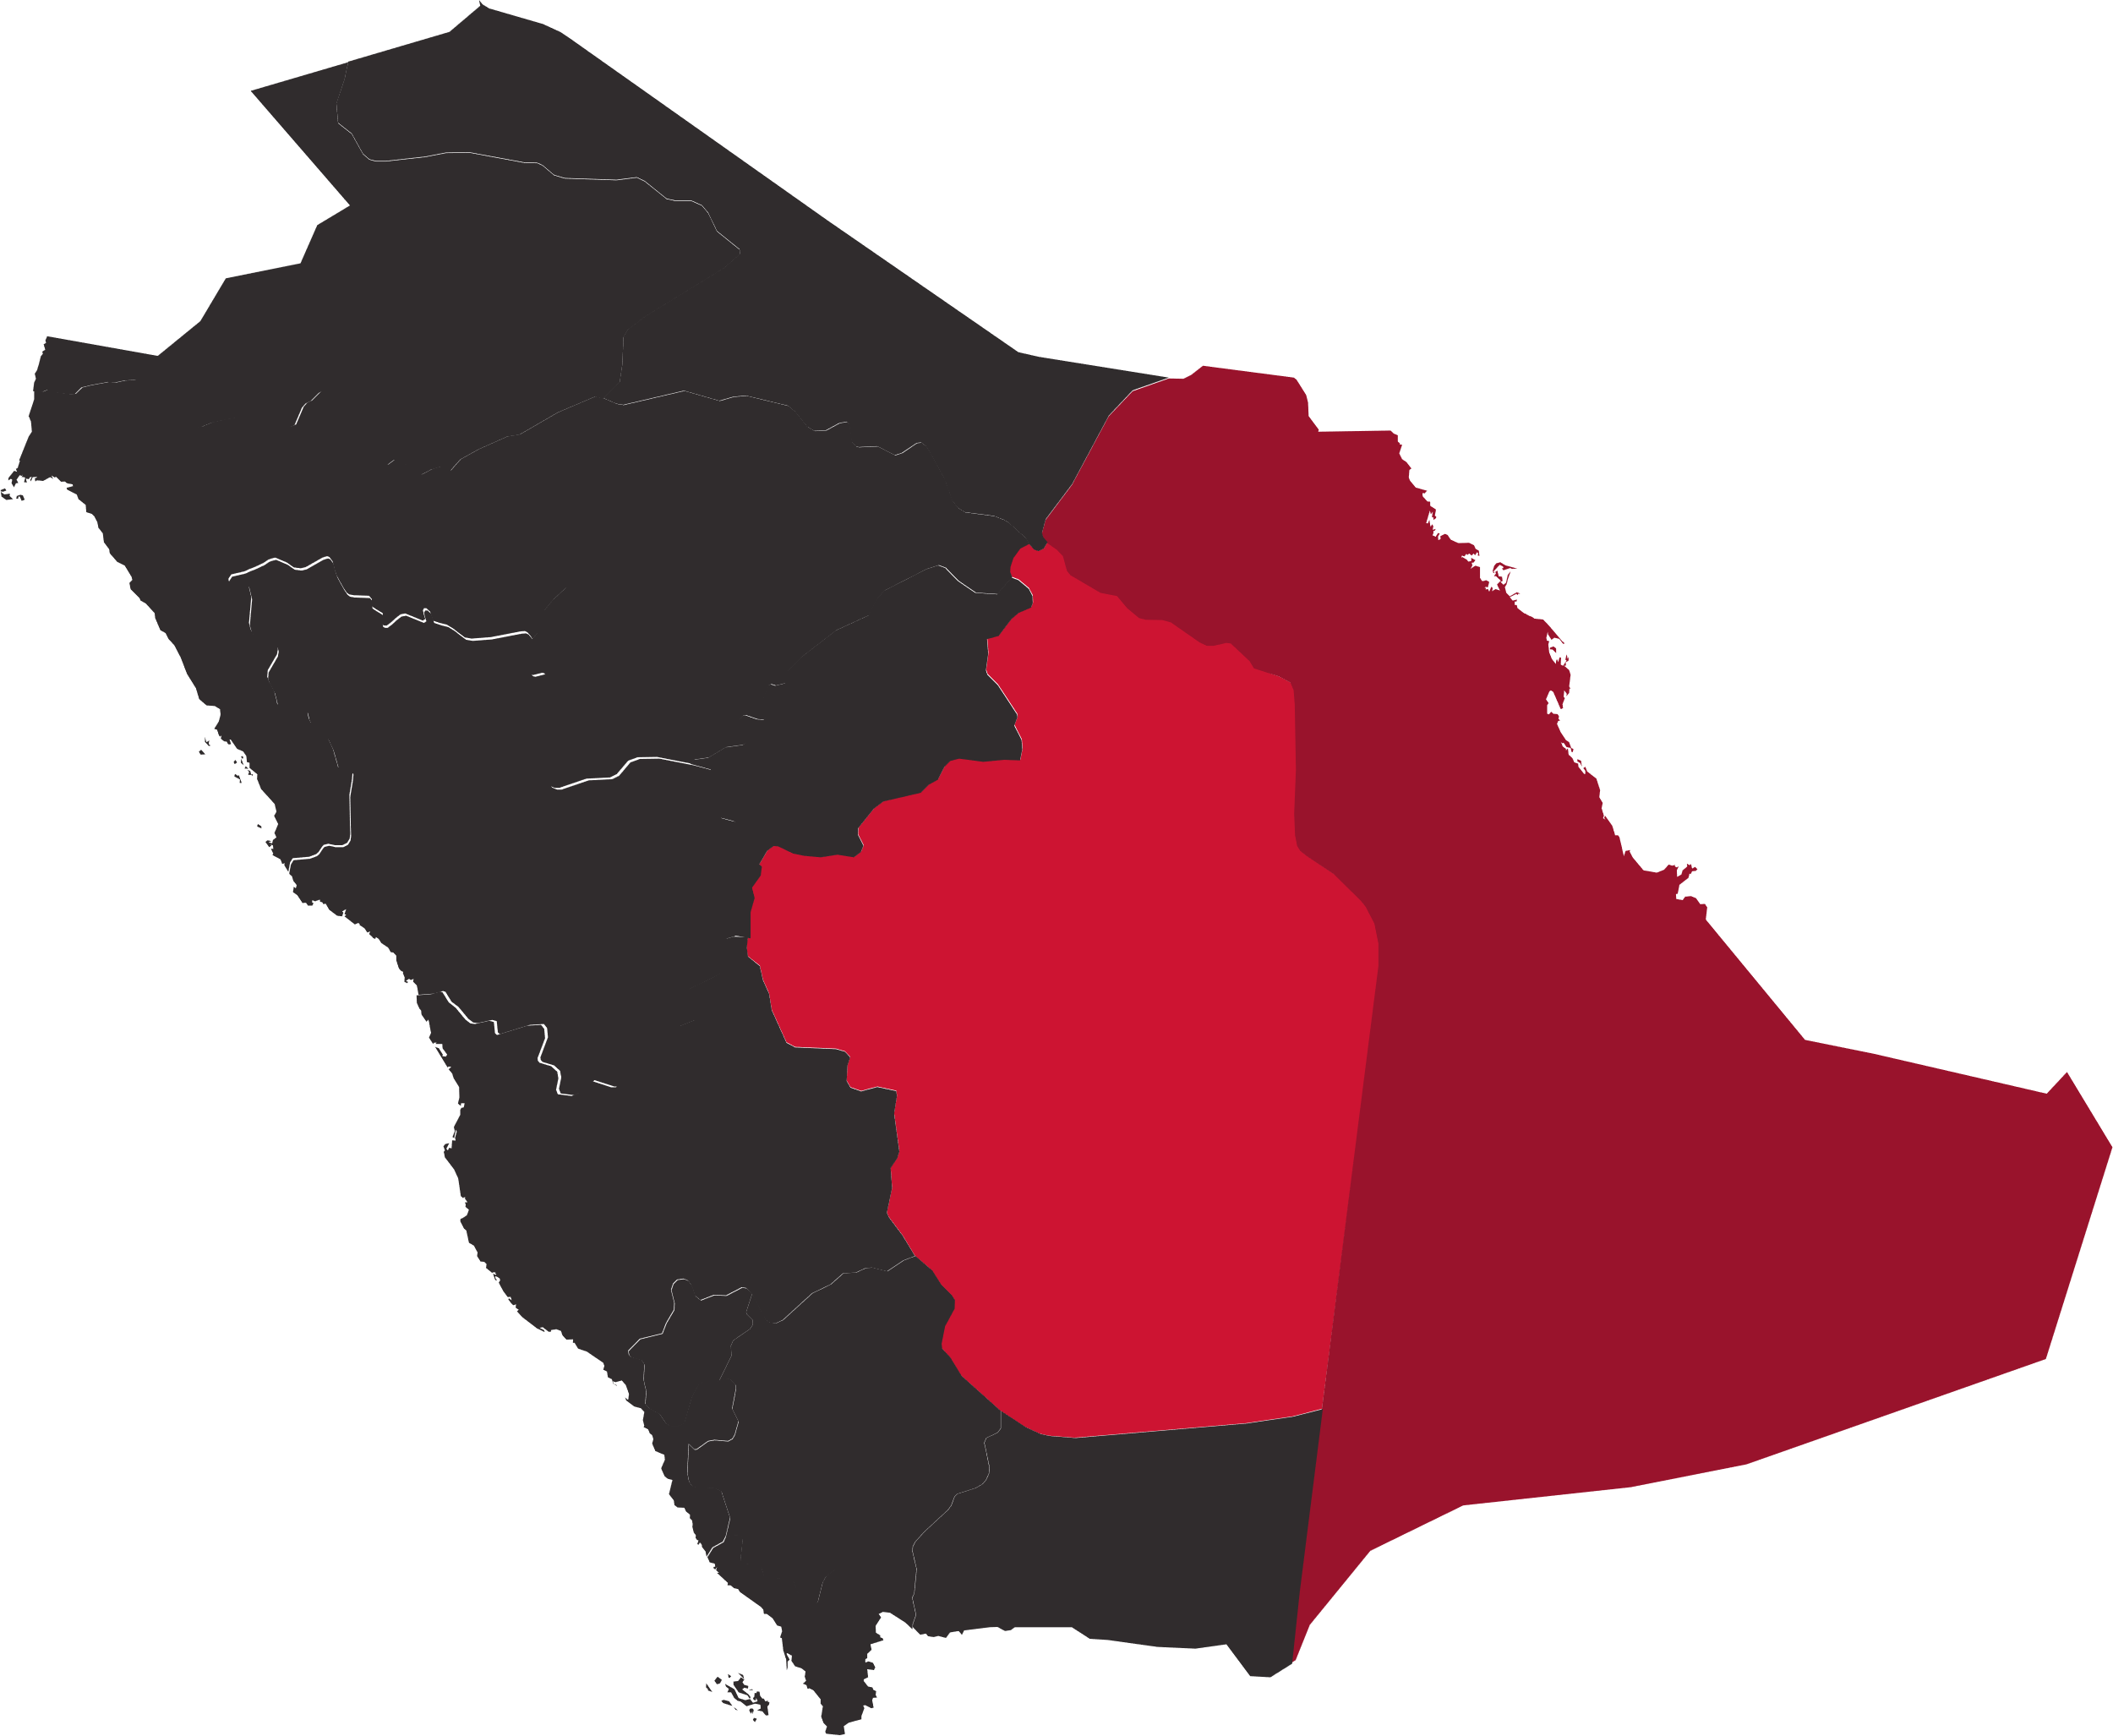

Dammam
Bashar Ibn Burd Street, Olaya
P.O Box 2849 Alkhobar, Saudi Arabia
Mob: +966 54 394 3660
Tel: +966 13 8058055
Riyadh
Headquarter Riyadh
King Abdulaziz (Exit 5)-Str. Al-Masif Area
P.O Box 9524 Riyadh 11423, Saudi Arabia
Tel.: +966 11 4615445
Fax: +966 11 4615810

