Slide 1

2022
Business Continuity Management & Internal Audit
As per The IIA Global Technology Audit Guide
www.ecovisalsabti.com

Slide 2
1
Program Governance
CONTENTS
2
Risk Management
3
Business Impact Analysis (BIA)
4
Business Continuity & Recovery Planning (BCRP)
5
Internal Audit Activities Before a Crisis
6
Internal Audit Activities During and After a Crisis
7
Conduct Audits of the Recovery Processes and Plan Effectiveness
8
Participate in the Broader Recovery Process
9
Sample Work Programs for BCM Assurance or Advisory Engagements

Slide 3

Muhammad Kashif – Speaker
BCM Practice Head – Ecovis AlSabti
  Muhammad Kashif is a well known BCM and GRC expert in the region. He has got vast experience is Business Continuity Management and related practices that has enabled several organizations to be resilient.
  He carries 18 years of experience, working in telecom and banking sectors, focused on Business continuity, Information security, technology risk management, control sciences, process optimization and technology governance areas.
  He has delivered variety of trainings, workshops and awareness sessions in public as well as in corporate sector.
You cannot positively influence your life when you are not emotionally strong. Strength comes from within.
Following are his credentials:
Certified Information Security Manager (CISM)
Certificate of Business Continuity Institute (CBCI)
ISO 27001 Lead Auditor
DevOps Fundamentals & Professional Levels
03| www.ecovisalsabti.com

Slide 4
1
Introduction to Business Continuity Management (BCM)
Take-on for
Today’s Session!
2
Internal Audit Evaluation of Key BCM Elements
3
Sample Work Programs for BCM Assurance or Advisory Engagements

Slide 5
Introduction to Business Continuity Management (BCM)
PART ONE
01

Slide 6
Follow International Best Practices
Protection of Brand & Reputation
Confidence of Clients
Competitive Advantage
Cost Reduction
Why Business Continuity Management
Business World !
Legal & Regulatory Compliance
Our Business / Organizations !
Continual Improvement
Maintenance of Vital Activities of Organization
Effective Response to Crisis
Building Resiliency
Respect of Stakeholders
06| www.ecovisalsabti.com

Slide 7

What is Business Continuity Management (BCM)?
“Plans and actions that provide protection and alternate modes of operation.”
Source: The Business Continuity Institute
“Capability of the organization to continue delivery of products or services at acceptable predefined levels following a disruptive incident.”
Source: ISO 22301 (2012)
07| www.ecovisalsabti.com

Slide 8

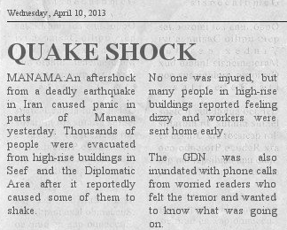
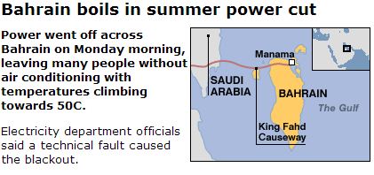
What could cause a business interruption?
Power Outage
Deep Sea Cable Cut
System Crash
Labour Disruption
Climate Change
Political Unrest
The list goes on……
We have seen it happen before!
Sources: Gulf Daily News and BBC News
08| www.ecovisalsabti.com

Slide 9
Why Do We Need Business Continuity Management (BCM)?
Generalized Approach
Q. Do we know what to do when we experience a business interruption?
Q. Who will be responsible to ensure the continuation of our business operations?
Q. How should we handle the media should a disaster affect the Ministry?
Q. How do we know that our recovery plan will work?
Answer: Implementing a Business Continuity Management System will help us answer these questions!
09| www.ecovisalsabti.com

Slide 10
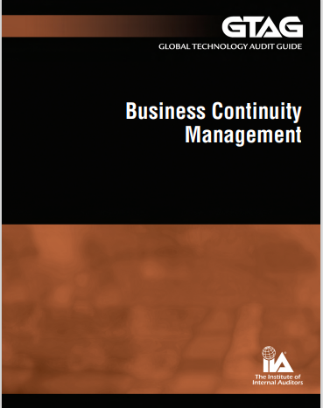
Why Do Need Business Continuity Management (BCM)?
Management Approach
Chief Audit Executive (CAE) should be able to answer the following three simple :
Does the organization’s leadership understand the current business continuity risk level and the potential impacts of likely degrees of loss?
Can the organization prove the business continuity risks are mitigated to an approved acceptable level and are recertified periodically?
If an unacceptable business continuity risk exists but executive management has decided to assume the risk, are the organization’s owners, business partners, and other constituents aware that management has decided not to mitigate the risk? Also, has the decision to accept the risk been properly documented?
If any of the answer is ‘No’ then GTAG BCM can help.
This guide aims to help CAEs understand the BCM program, risks, and controls and to prepare them with information for executive- and board-level discussions.
10| www.ecovisalsabti.com

Slide 11
1
Introduction to Business Continuity Management (BCM)
Take-on for
Today’s Session!
2
Internal Audit Evaluation of Key BCM Elements
3
Sample Work Programs for BCM Assurance or Advisory Engagements

Slide 12
Internal Audit Evaluation of Key BCM Elements
PART TWO
02

Slide 13
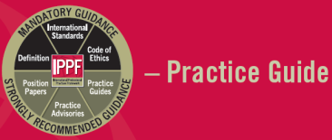

BCM and Internal Audit
BCM and Internal Audit needs to be considered as allies for the following factors:
Aligned objectives – Business and Risk
Confidentiality, Integrity and Availability of the organization key services
Detailed risk and controls testing by IA as part of their audit coverage
Follow-up on residual risk toward mitigation
Avoidance of duplication of effort
13| www.ecovisalsabti.com

Slide 14
BCM Key Elements
Internal Audit evaluation of key BCM elements includes the following:
7. Participate in the Broader Recovery Process
2. Business Impact Analysis
4. Business Continuity & Recovery Planning (BCRP)
6. Conduct Audits on the Recovery Processes and Plan Effectiveness
1. Program Governance
3. Risk Management
5. Internal Audit Activities Before, During and After Crisis
15| www.ecovisalsabti.com

Slide 15

Program Governance - as per BCMS ISO 22301 Standard
Program Governance is established at the start of the BCM Lifecycle and covers the following:
4. Programme Management
3. Governance Framework
2. Organizational Policy
1. Aligning BCM Programme to Organization Objective
16| www.ecovisalsabti.com

Slide 16

Program Governance
The key to successful BCM is the support and sponsorship of executive management. Internal Audit need to perform the following activities:
Determine whether key leadership positions have been documented and approved
Recommend the development of a BCM charter
Evaluate if an established BCM and CM governance structure is adequately funded, appropriate and effective
Apprise the board (audit committee) of the risks associated with, and current best practices for, BCM and CMPs
17| www.ecovisalsabti.com

Slide 17


Program Governance - as per BCMS ISO 22301 Standard
Reviews and assesses an organization in terms of what its objectives are, how it functions and the constraints of the environment in which it operates.
Techniques used:
Business Impact Analysis:
Identifying Activities
Impact Assessment
Prioritizing
Departments
Economical Impact
8-24 Hours
Impact
Non-Economical Impact
1-3 days
45 Minutes
Organization
Statistics
MTPD
RTO
Process/ activities
RTO < MTPD
Time
18| www.ecovisalsabti.com

Slide 18
Business Impact Analysis – as per IIA Guide
Internal audit may provide guidance on how management can perform a BIA
The results of the BIA will likely drive the levels of pre-emptive actions, coverage, and risk appetite to be assumed by the organization
BIA, if performed effectively, may ultimately drive investment priorities for a BCP and related CMP.
19| www.ecovisalsabti.com

Slide 19
Risk Management – as per ISO 22301 Standard
5 Stages of Risk Assessment Process
Technique that helps to identify, assess and control risks, which if not prevented might stop an organization from achieving its business and regulatory objectives.
Types of Risks to consider are:
Natural Risks
Man-made Risks
Reputational Risks
Technological Risks
Health & Safety Risks
Operational Risks
1- Identify
2- Analyze
3- Evaluate
4- Treat
5- Monitor
20| www.ecovisalsabti.com

Slide 20
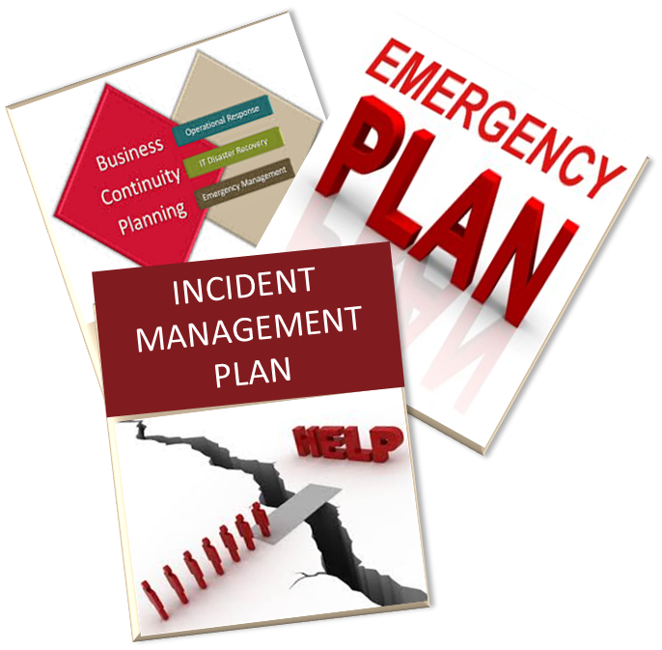
Business Continuity and Recovery Planning ISO 22301 Standard
Identifies, selects and documents appropriate strategies and tactics to determine how continuity and recovery from disruption will be achieved:
People
Premises
Technology
Information
Suppliers & Partners
Areas Considered while designing the Solution
21| www.ecovisalsabti.com

Slide 21

Business Continuity and Recovery Planning
Provides a proactive method by which organizations can identify business continuity and recovery measures
Manages and mitigates key organizational risks triggered by a crisis.
Internal audit may provide advisory or assurance services related to BCRP
22| www.ecovisalsabti.com

Slide 22

Internal Audit Activities: Before a Crisis
Share knowledge of leading developments for BCM
Consider residual risks in the development of the annual audit plan
Evaluate key business partner arrangements for appropriate contractual terms
Advise management on the performance of BCM risk assessments
Perform assurance engagements related to the BCP/ CMP, as part of the annual audit plan
Clarify and establish BCM roles for internal audit
23| www.ecovisalsabti.com

Slide 23
Internal Audit Activities: During a Crisis
Monitor and assess the organization’s response to an event and be an active participant on the crisis management team
Monitor outage details for subsequent audits
Participate in the wider crisis management and recovery process
Ensure that risks associated with a crisis are understood and appropriate recommendations are provided
24| www.ecovisalsabti.com

Slide 24
Internal Audit Activities: After a Crisis
Evaluate and report on the effectiveness of the organization’s recovery efforts
Continue to assess risk, provide guidance, and help develop business improvement efforts
Perform assurance engagements to evaluate whether the results of root-cause analysis is appropriately considered to update the BCP and CMP, as needed.
Perform post-crisis reviews
25| www.ecovisalsabti.com

Slide 25

Conduct Audits of the Recovery Processes and Plan Effectiveness
An end-to-end review of the recovery process
An audit of the effectiveness of the recovery process
A review of controls and special processes introduced outside the normal control framework
An audit of management’s data recovery processes
A review of actual BCP and CMP variations following activation of the plans
Recovery
26| www.ecovisalsabti.com

Slide 26

Participate in the Broader Recovery Process
Internal auditors may be requested by organizational leadership to lend additional support to operational staff who are either:
Working on recovery processes
Working on revisions to normal business processes
Using alternate defined procedures to carry out activities for which normal processes have been disrupted
27| www.ecovisalsabti.com

Slide 27
1
Introduction to Business Continuity Management (BCM)
Take-on for
Today’s Session!
2
Internal Audit Evaluation of Key BCM Elements
3
Sample Work Programs for BCM Assurance or Advisory Engagements

Slide 28
Sample Work Programs for BCM Assurance or Advisory Engagements
PART THREE
03

Slide 29
BCM Sample Work Program
An audit considers five aspects of the BCM as follows:
1. Business Environment & Strategy
2. BCP Methodology & Strategy
BCM Aspects for Internal Audit
3. BIA ( Risk Evaluation & Controls)
4. Recovery Plan
5. Awareness, Testing & Training
30| www.ecovisalsabti.com

Slide 30
BCM Sample Work Program (Contd.)
Possible items to be considered for each BCM aspects are as follows:
1
Industry
Business Environment & Strategy
External Dependencies
2
Business Strategy
BCP Methodology & Strategy
Operational/ Technical Strategy
Financial Strategy
3
Tone at the Top
BIA ( Risk Evaluation & Controls)
Risk Assessment
Mitigation
4
Recovery Point Objective (RPOI)
Recovery Plan
Recovery Time Objective (RTO)
Testing Policy
5
Testing Strategy
Awareness, Testing & Training
Testing Observations
Post-Testing
Training
31| www.ecovisalsabti.com

Slide 31

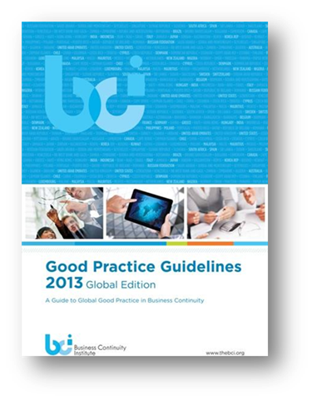
Knowledge Progression – Qualifications in BCM
  PECB – ISO 22301 Lead Auditor and Lead Implementer
  5 Days Instructor Lead Training and Exam
CBCI Certification – Instructor Based Qualifications
  4 Days Instructor Lead Training and Exam
32| www.ecovisalsabti.com

Slide 32

Question &
Answers

