Slide 1


BCM as a Managed Service
8th November 2023
ecovisalsabti.com

Slide 2

Take Away of the Session
1. “Managed BCM”; a Myth or a Reality? Can BCM be managed as a Service?
2. BCM is a living management system, likewise any other management systems (True/False)?
3. What does a BCM Team/Manager assess in an
organization during a calendar lifecycle?
Million Dollar Questions
4. What does best practice says about the Managed BCM?

Slide 3




My Introduction
Muhammad Kashif
Service Line Head – Organization Resilience & BCM
Experience
More than 20 Years of Experience
Expertise
Expertise in BCM, GRC, ISM, and BPR
Projects
Delivered 20+ large scale BCM projects in various industry verticals

Slide 4
Relationship of the BCM & the PDCA Cycle

Slide 5

The PDCA Cycle
Maintain & Improve
Establish
ACT
PLAN
BCM
CHECK
DO
Monitor & Review
Implement & Operate

Slide 6

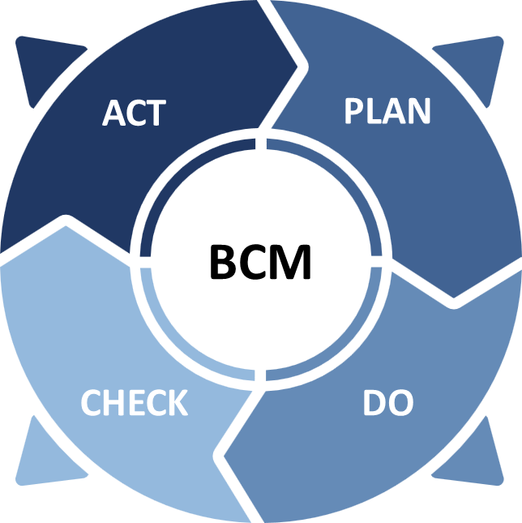

Relationship between BCM and PDCA Cycle
PDCA CYCLE
Tools to Govern BCM Improvements
Continual Improvement
BCM Policy
BCM Framework
BCM Plans and Procedures

Slide 7
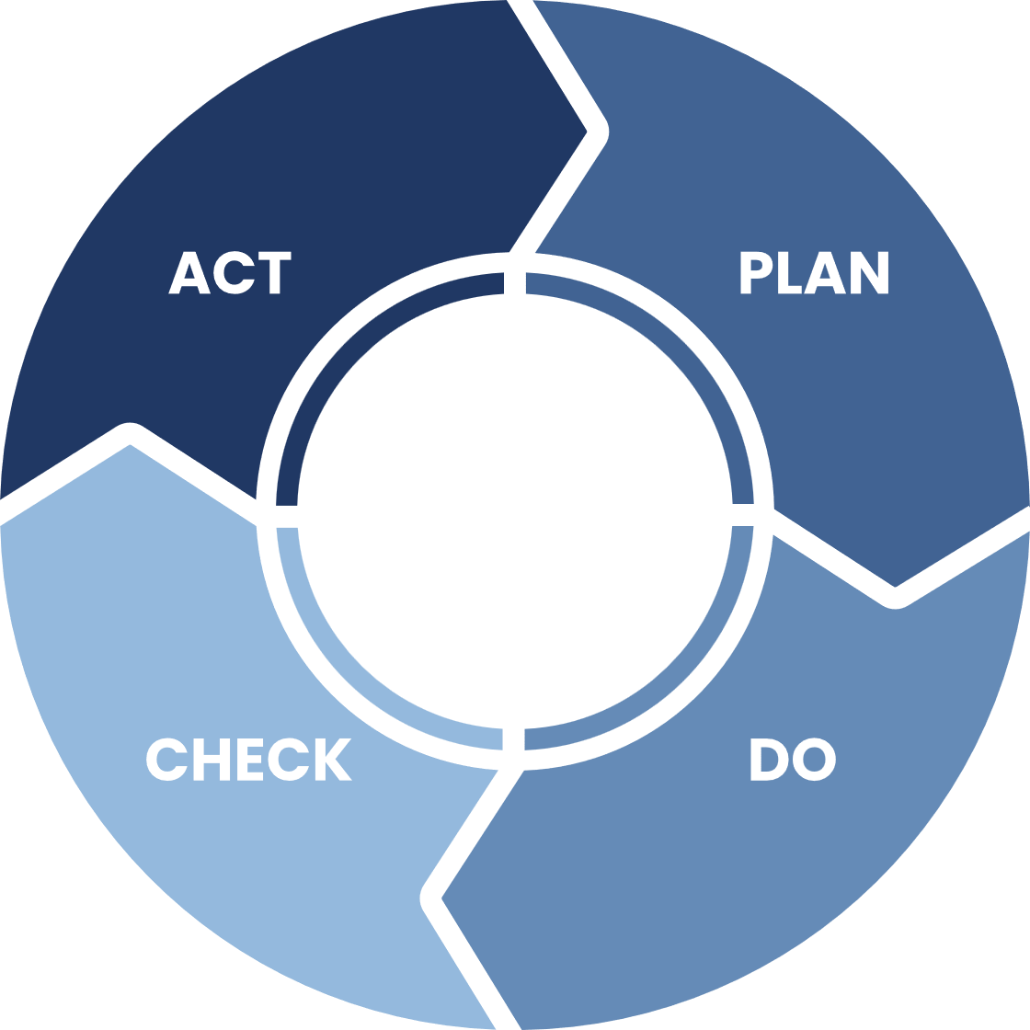
Relationship between BCM and PDCA Cycle
THREE PILLARS
Plan
Do
Check
Act
1
2
3
4
GAP Assessment
BCM Governance
Exercising
Awareness
Planning
BIA & TRA
Maintenance
Corrective Actions
Implementation Roadmap
Recovery Strategies
Review
Bus. Continuity Response Plans

Slide 8
Why the PDCA model is important?
Identify Gaps in
Business Continuity Management System
(BCMS)
Assess BCM Changes across
the organization
Assess the
Org. Resilience
Align with
International best practices of BCM
Set Roles &
Responsibilities
Of Stakeholders
Monitor Risks & Threats
of Continuity
Promote Risk Culture
and
BCM Awareness

Slide 9
Three Pillars of Managed BCM

Slide 10
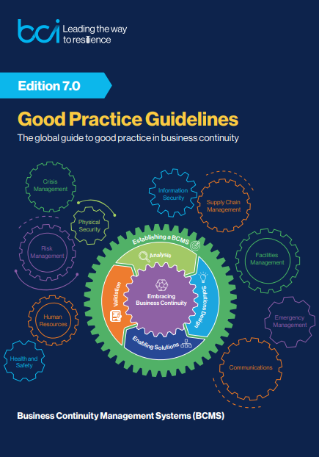
Three Pillars for Managed BCM
Validation is achieved through a combination of the following three activities:
Exercising
Maintenance
Review
Managed BCM (Validation)
Ref: BCI Good Practice Guideline, Edition 7.0 - Released Date: 1st November 2023
Exercising
Maintenance
Review

Slide 11
Three Pillars for Managed BCM
BCM as a Managed Service
Exercising
Maintenance
Review

Slide 12
Three Pillars for Managed BCM (Pillar 1: Exercising)
Managed BCM (Validation)
Exercising
Maintenance
Review

Slide 13
Three Pillars for Managed BCM (Pillar 1: Exercising)
Managed BCM (Validation)
Exercising
Maintenance
Review

Slide 14
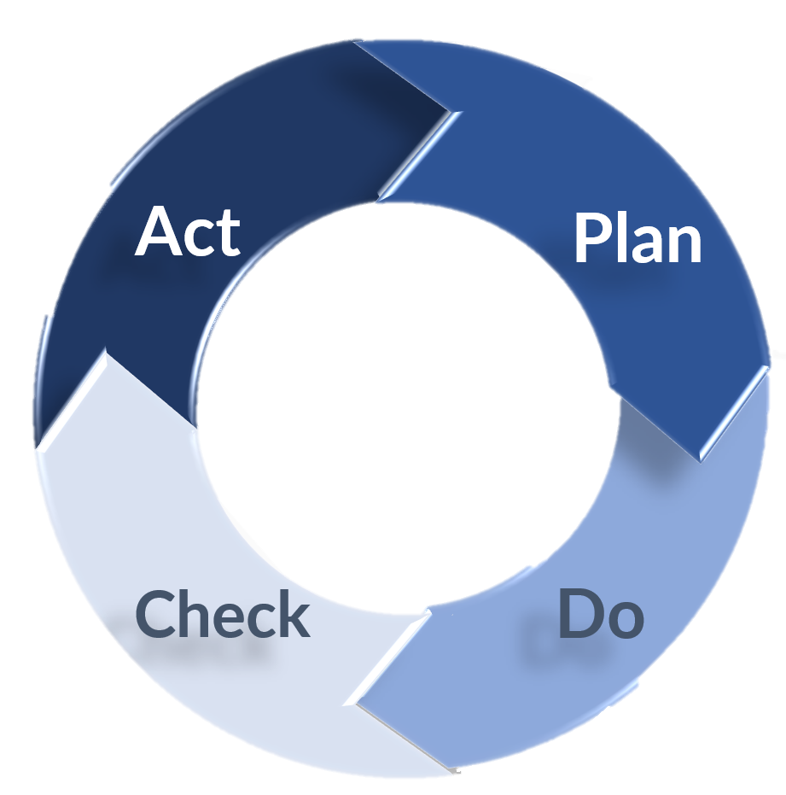
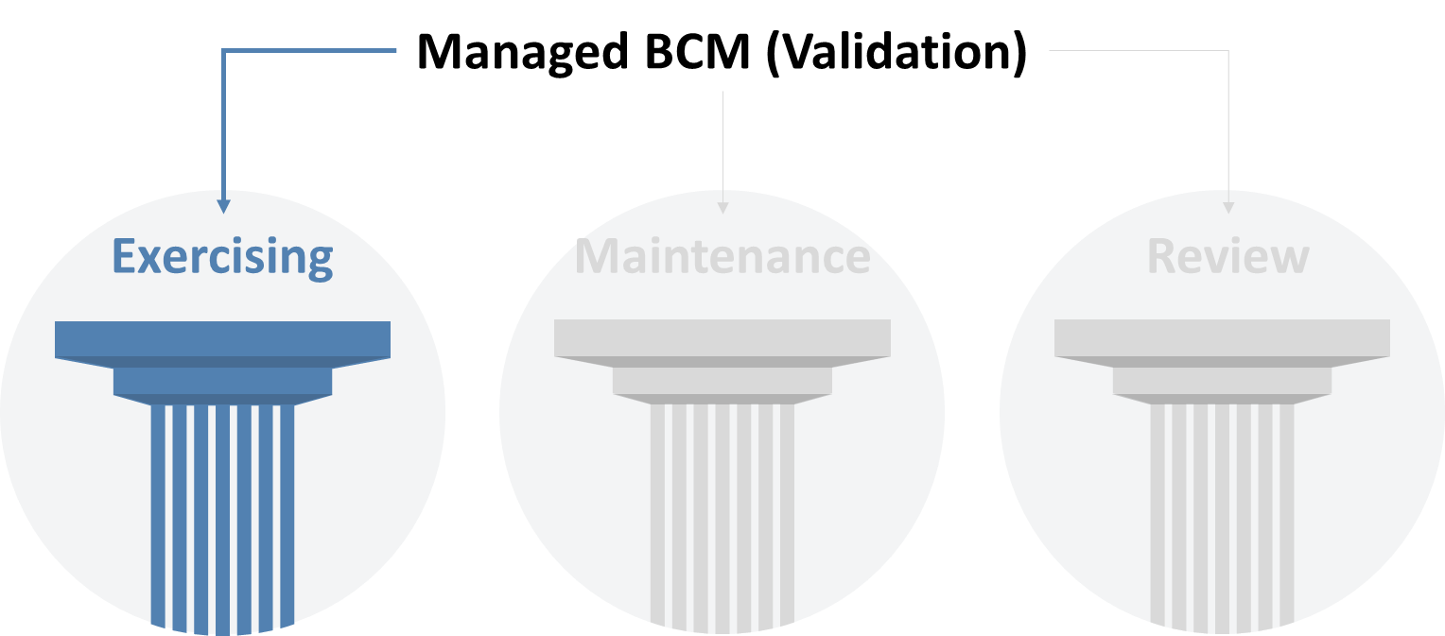
Three Pillars for Managed BCM (Pillar 1: Exercising)
What is Exercising?
Why to Exercise?
Establishing
the
Foundation
A process to train for, test, assess, practice, and improve the business continuity capability of the organization.
Reality Check
Improvement & Enhancement
Increasing Staff Competency
Accuracy of BCM Docs
Creates awareness & Teamwork
Improvement
Planning
Design, &
Development
How to
Exercise?
An organization’s continuity capability cannot be considered reliable or effective until it has been exercised.
Ref: BCI Good Practice Guideline
Conducting

Slide 15
Three Pillars for Managed BCM (Pillar 1: Exercising)
1.
Define Exercise Goal, Objective, Scope, and Outcome
2.
Identify
the Exercise Planning Team and team’s role
3.
Review
Current Risks and Threats
Pre-Exercise
4.
Plan & Design the Exercise, with Mgmt. Approval
5.
Choose the
Type of Exercise
RESILIENCE
Business Continuity Plan(s)
BCM Strategy
Exercising Process
Disaster Recovery Plan(s)
Third Party Contracts / Services
6.
Conduct the Exercise
Technology & Infrastructure
Awareness & Training Program
Exercise
Improvements
Corrective Actions Enhancements
Staff Roles & Responsibilities
7.
Lessons Learned
Report (LLR), debrief participants
immediately after
the exercise.
8.
Follow up the Lesson Learnt & Corrective Actions (If any)
Lesson Learnt Report (LLR)
Post-Exercise
Document which records, describes and analyses the exercise, drawing on debriefs and reports from observers, and derives lessons from it (Ref: ISO 22398 Guidelines for exercises and testing)

Slide 16
Three Pillars for Managed BCM (Pillar 1: Exercising)
Exercising Roadmap
# | BCP | Exercise Objective | Exercise Scenario | Type of Exercise | Stakeholder / Owner | Q1 | Q2 | Q3 | Q4
1 | BCP Ops Dept | To validate concerned stakeholder’s Roles & Responsibilities, and knowledge of recovery procedures | Disruption of Operations …………… | Walkthrough of Plan | Stakeholder Name
2 |  | To validate RTO of Technology Components | Disruption of Application System …………… | Simulation | Stakeholder Name
3 |  | To Validate Logistical System | Staff relocation to alternative site………. | Exercising critical activities | Stakeholder Name
4
5

Slide 17
Three Pillars for Managed BCM (Pillar 2: Maintenance)
Managed BCM (Validation)
Exercising
Maintenance
Review

Slide 18
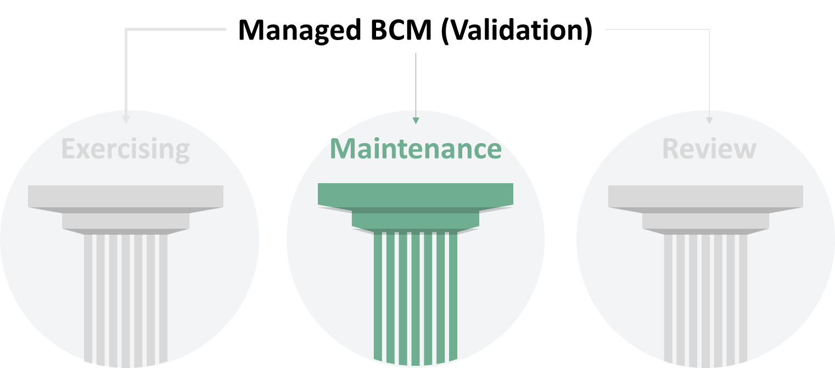
Three Pillars for Managed BCM (Pillar 2: Maintenance)
Maintenance Process
What is Maintenance?
A process to ensure that the organization’s business continuity arrangements and plans are kept relevant, up-to-date, and operationally ready to respond.
.
1.
Identify
The Changes in the Org
2.
Analyze
the
Changes Impact
3.
Identify & Agree the corrective actions required in BCMS
Improvements
Corrective Actions Enhancements
4.
Apply the changes
in BCMS
5.
Identify additional requirements such as Awareness, training
Why to perform Maintenance?
Effective Change Management
Audit and Compliance
Corrective Actions
Accuracy of BCM Docs
6.
Plan
for the next Maintenance
RESILIENCE
Documented Planned Maintenance Schedule
Regular Progress Report
Effective UpToDate Policy and Procedure Docs.
UpToDate Documentation
Distribution to the interested parties
Awareness & Training Program

Slide 19
Three Pillars for Managed BCM (Pillar 3: Review)
Managed BCM (Validation)
Exercising
Maintenance
Review

Slide 20
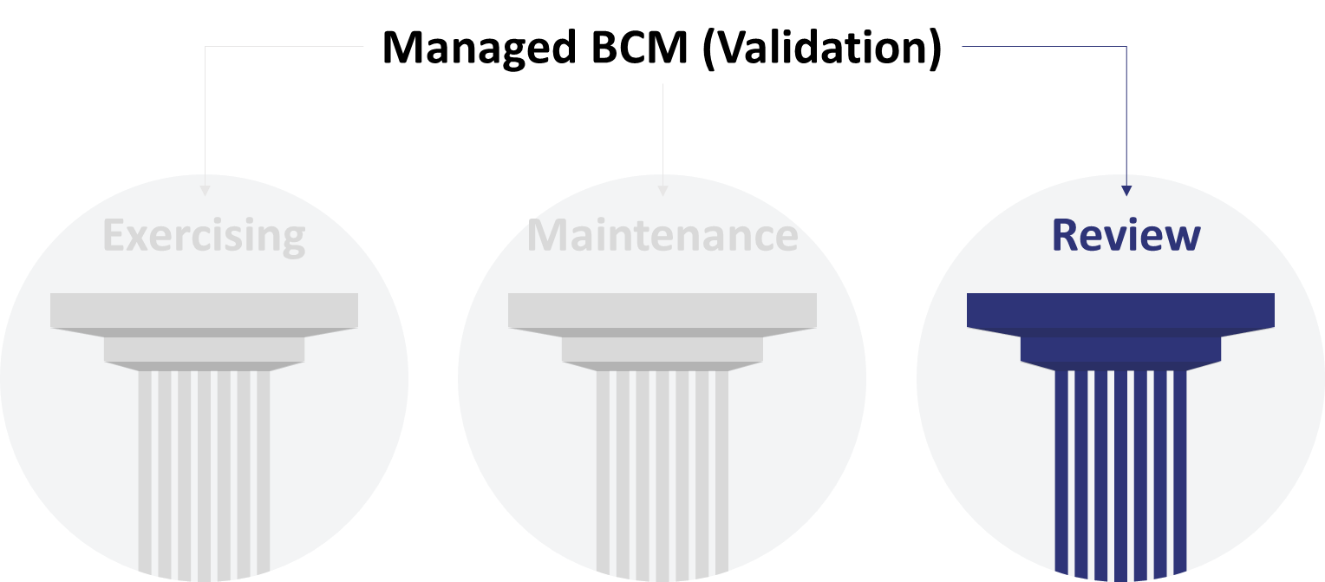
Three Pillars for Managed BCM (Pillar 3: Review)
What is Review?
Types of Review?
Why is Review performed?
The purpose of a review is to evaluate the business continuity policy and programmed for continuing suitability, adequacy, and effectiveness.
Audit (Internal / External)
Self Assessment
Management Review
Performance Review
Supplier Performance
Quality Assurance
Identifying Gaps and Nonconformities
Corrective Actions for Improvements
Improved posture of resilience
Review Process
RESILIENCE
1.
. Identify the
Gaps based on the conducted review
2.
Identify &
Agree the corrective actions required in BCMS.
Business Continuity Plan(s)
BCM Strategy
3.
Take corrective actions as per the target date.
Improvements
Corrective Actions Enhancements
Disaster Recovery Plan(s)
Third Party Contracts / Services
Technology & Infrastructure
Awareness & Training Program
Staff Roles & Responsibilities

Slide 21
Risks Associated with an
Outdated BCM Program

Slide 22


Risks Associated with an Outdated BCM Program
Vulnerabilities
Reputational Losses
Competitive Disadvantage
Noncompliance
Disruption
Misalignment of BCMS and Business
Financial Impact
Continuity
Risks

Slide 23
Key Benefits of a Managed Service Model

Slide 24


Key Benefits of a Managed Service Model
Continual Improvement brings Better Resilience
Continuous
Improvement
Continuous
Improvement
Managed BCM Validation
Exercising
Maintenance
Review
STANDARD
Quality Improvement
STANDARD
Consolidation Through
Standardization
Time

Slide 25

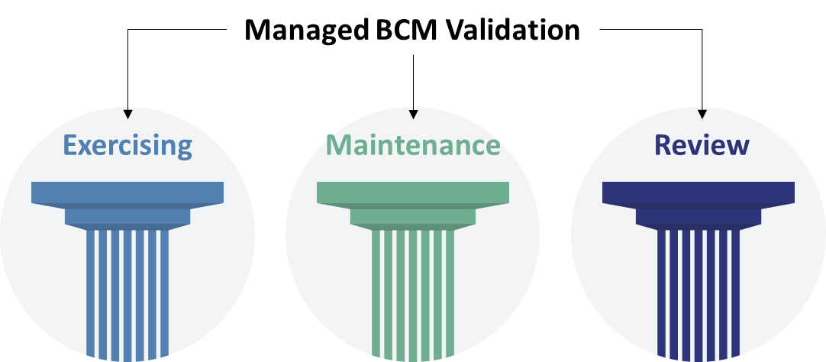
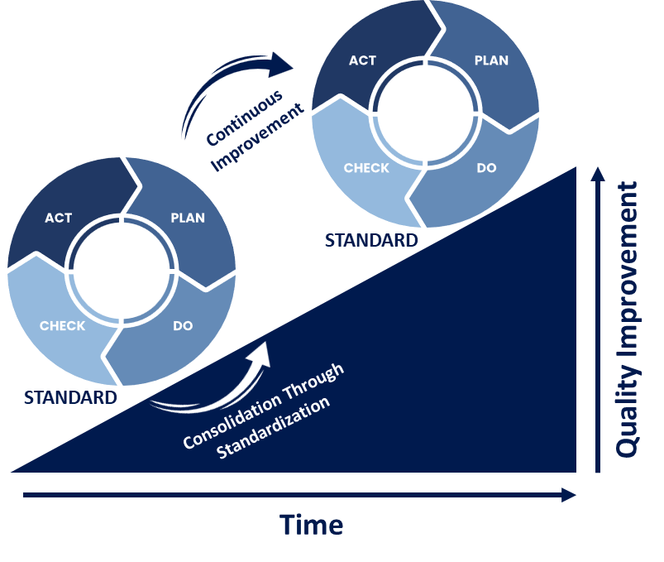
Take Away of the Session
(Million Dollar Questions)
Answers
References
1. “Managed BCM” a Myth or a Reality? Can BCM be managed as a Service?
Reality
2. BCM is a living management system, likewise any other management systems (True/False)?
True
3. What does a BCM Team/Manager assess in an
organization during a calendar lifecycle?
Continual Improvement
4. What does best practice says about the Managed BCM?
Exercising, Maintenance, Review

Slide 26
Thank You – Questions Please!

